Slide 1

FORECAST OF FOOTFALLS
HARISH.V

Slide 2

TASKS
CHECK FOR NULL VALUES IN DATA
LOAD IT INTO PYTHON AND DO A EDA
FIT THE MODEL
CHECK THE EFFICIENCY USING MAPE AND RMSE

Slide 3
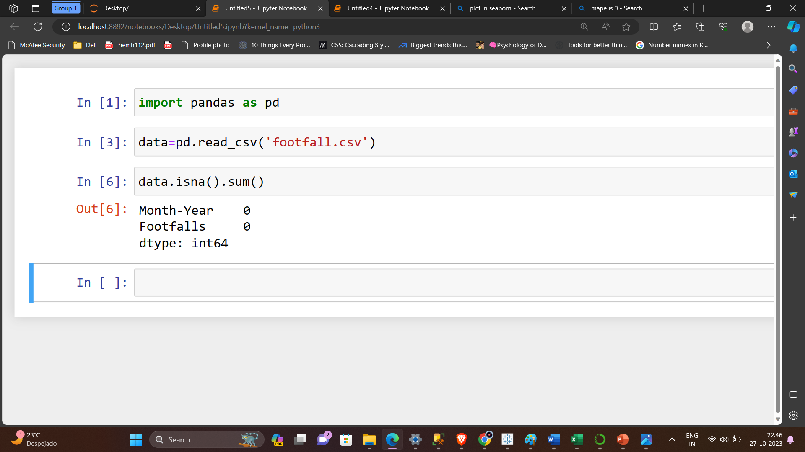
DATA

Slide 4

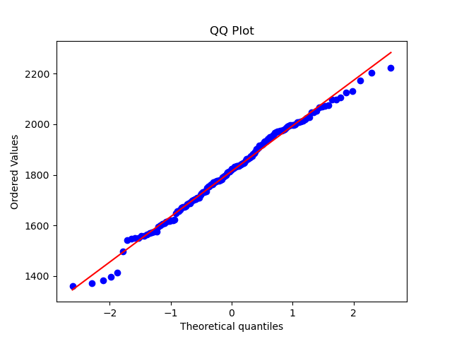
Distribution of data

Slide 5
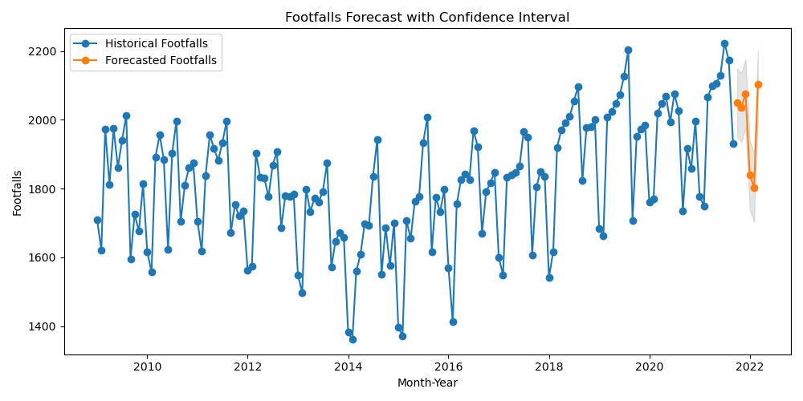
Forecast

Slide 6
Rmse and mape
Rmse=203
Mape=0

Slide 7


Thank you

